Slide 1


CE142: OBJECT ORIENTED PROGRAMMING WITH C++
December – April 2019
Unit– 09
Inheritance
Devang Patel Institute of Advance Technology and Research

Slide 2
Introduction
Reusability is an important feature of OOP.
  The mechanism of deriving a new class from an old one is called inheritance (or derivation).
  The old class is referred to as base class.
  The new class is called the derived class or subclass
The derived class inherits some or all of the traits from the base class.
A class can also inherit properties from more than one class or from more than one level.

Slide 3
Single Inheritance
A derived class with only one base class.
A
B

Slide 4

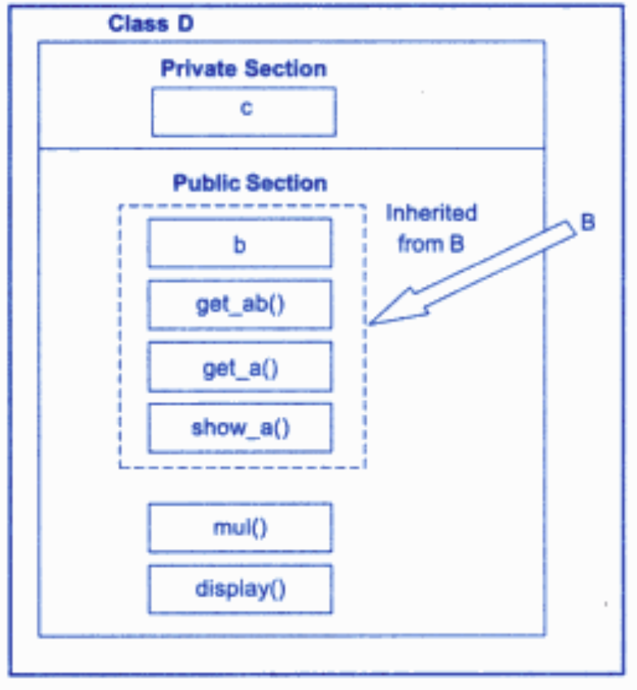
Single Inheritance

Slide 5
Multiple Inheritance
A derived class with several base classes.
A
B
C

Slide 6
Hierarchical Inheritance
A traits of one class may be inherited by more than one class.
A
B
C
D

Slide 7
Multilevel Inheritance
The mechanism of deriving a class from another derived class.
A
B
C

Slide 8
Hybrid Inheritance
The mechanism of deriving a class by using a mixture of different methods.
A
B
C
D

Slide 9
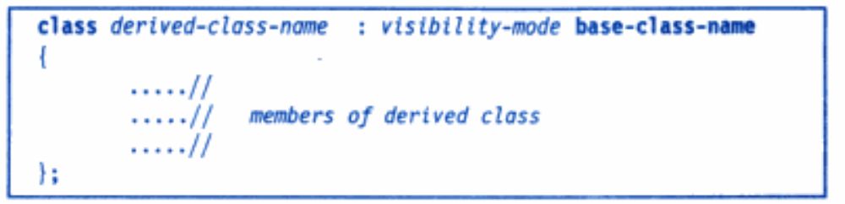
Derived Classes
Visibility mode is either private or public or protected
  By default its private
  It specifies whether the features of the base class are privately derived or publicly derived

Slide 10
Derived Classes
class derived-class-name : visibility-mode base-class-name
{
………//
………// members of derived class
………//
};
The visibility mode is optional and , if present, may be either private or public.
The default visibility mode is private.
Visibility mode specifies whether the features of the base class are derived privately or publicly.
The colon indicates that the derived-class-name is derived from the base-class-name

Slide 11
Prg-1
#include <iostream>
using namespace std;
class A
{
public:
void display()
{
cout<<"Base class content.";
}
};
class B : public A
{
};
int main()
{
B obj;
obj.display();
return 0;
}
O/P
Base class content

Slide 12
Prg-2
#include <iostream>
using namespace std;
class A
{
private:
void display()
{
cout<<"Base class content.";
}
};
class B : public A
{
};
int main()
{
B obj;
obj.display();
return 0;
}
O/P
void A::display()' is private

Slide 13
Prg-3
#include <iostream>
using namespace std;
#include <stdio.h>
class A
{
public:
int i;
void display()
{
cout<<"Base class content.";
}
};
class B : public A
{
};
int main()
{
B obj;
obj.display();
obj.i=10;
printf("%d",obj.i);
return 0;
}
O/P
Base class content. 10

Slide 14
Prg-4
#include <iostream>
using namespace std;
#include <stdio.h>
class A
{
private:
int i;
public:
void display()
{
cout<<"Base class content”;
}
};
class B : public A
{
public:
seti()
{
i=10;
}
};
int main()
{
B obj;
obj.seti();
obj.display();
return 0;
}
O/P
Error: ‘int A::I is private’

Slide 15
Prg-5
#include <iostream>
using namespace std;
#include <stdio.h>
class A
{
private:
int i;
public:
void display()
{
cout<<"Base class content Value.“<<i;
}
int seti()
{
i=10;
}
};
class B : public A
{
};
iint main()
{
B obj;
obj.seti();
obj.display();
return 0;
}
O/P
Base class content Value: 10

Slide 16
Derived Classes: Public Visibility
When a base class is publicly inherited, ”public members” of the base class become the “public members” of the derived class.
They are accessible to the objects of the derived class.
The private members of the base class are not inherited in both the cases (publicly/privately inherited).
The private members of a base class will never become the members of its derived class.

Slide 17
Derived Classes : Private Visibility
When a base class is privately derived by a derived class, “public members” of the base class become “private members” of the derived class.
Therefore the members of the derived class can only access the public members of the base class.
They are inaccessible to the objects of the derived class.
No member of the base class is accessible to the objects of the derived class.

Slide 18
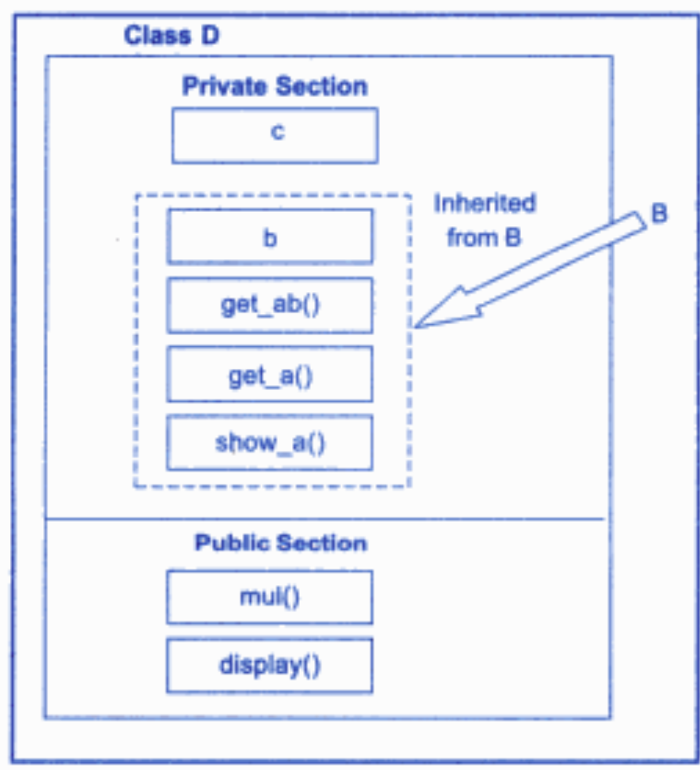
Derived Classes : Private Visibility

Slide 19
Prg-1
#include <iostream>
using namespace std;
class A
{
public:
void display()
{
cout<<"Base class content.";
}
};
class B : private A
{
};
int main()
{
B obj;
obj.display();
return 0;
}
O/P
Base class content
Error

Slide 20
Prg-1
#include <iostream>
using namespace std;
class A
{
public:
void display()
{
cout<<"Base class content.";
}
};
class B : private A
{
public:
void displayderive()
{
display();
}
};
int main()
{
B obj;
obj.displayderive();
return 0;
}
O/P
Base class content

Slide 21
Inheritance
In inheritance, some of the base class data elements and member functions are inherited into the derived class.
We can add our own data and member functions for extending the functionality of the base class.
It is a powerful tool for incremental program development.
Can increase the capabilities of an existing class without modifying it.

Slide 22
Single Inheritance
A
B

Slide 23
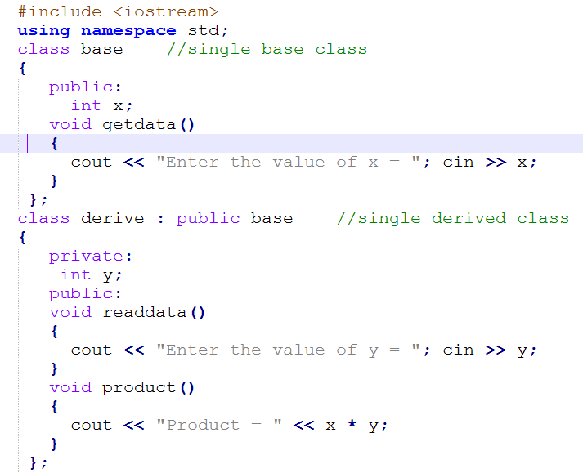

Slide 24
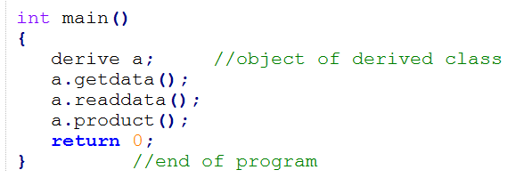

Output:

Slide 25
Making a Private Member Inheritable
By making the visibility limit of the private members to the public.
The visibility modifier “protected” can be used for this purpose.
A member declared as “protected” is accessible by the member functions within its class and any class immediately derived from it.
It can not be accessed by the functions outside these two classes.

Slide 26
Making a Private Member Inheritable
continue …
class alpha
{
private : // optional
……… // visible to the member within its class
………
protected :
……… // visible to member functions
……… // of its own and immediate derived class
public :
……… // visible to all functions
……… // in the program
};

Slide 27
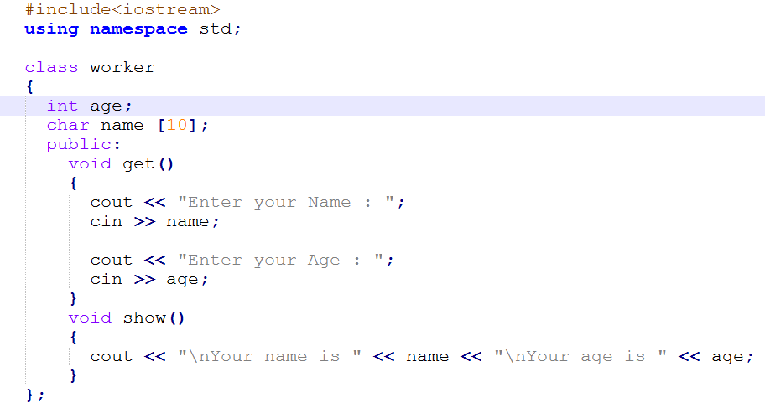

Slide 28
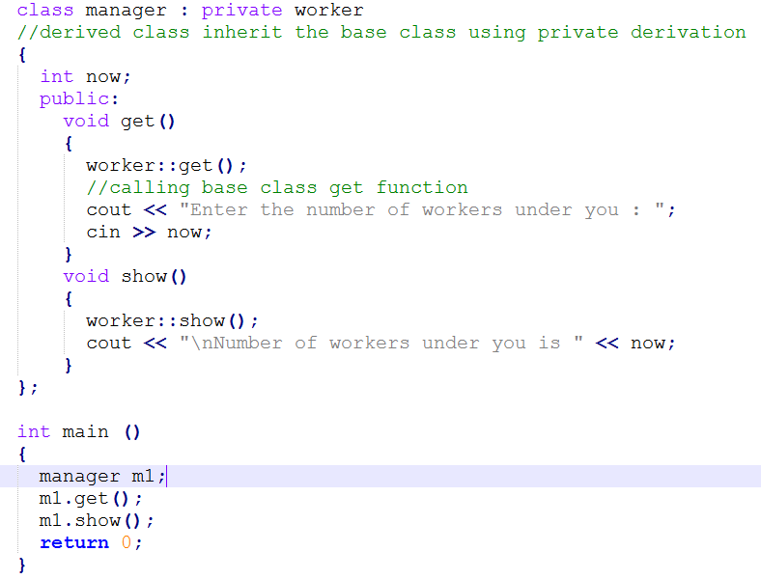

Slide 29
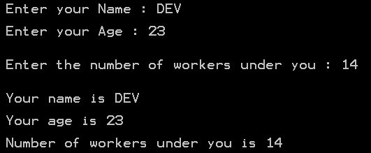
Output:

Slide 30
Protected Member
When a protected member is inherited in public mode, it becomes protected in the derived class.
They are accessible by the member functions of the derived class.
And they are ready for further inheritance.
When a protected member is inherited in private mode, it becomes private in the derived class.
They are accessible by the member functions of the derived class.
But, they are not available for further inheritance.

Slide 31
Protected Derivation
It is possible to inherit a base class in protected mode – protected derivation.
In protected derivation, both the public and protected members of the base class become protected members of the derived class.

Slide 32
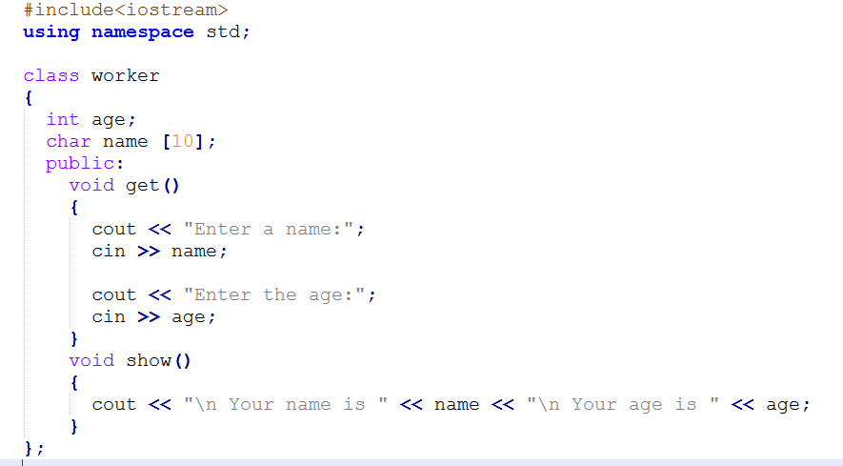

Slide 33
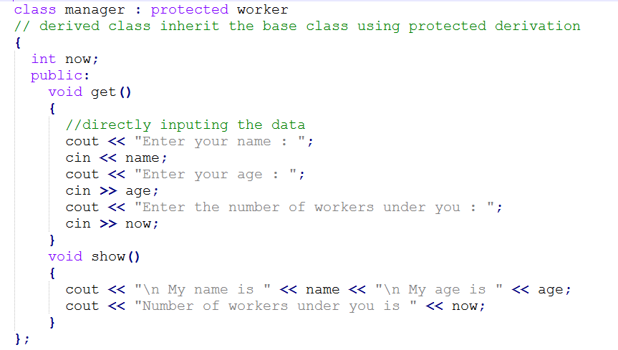

Slide 34
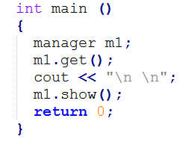
Output ???
This program will give error at the time of compilation as the class is protected and code is trying to access the private components of the class.

Slide 35
Effect of Inheritance on the visibility of Members
Class B
Not inheritable
Private
Not inheritable
Protected
Public
Class D1 : public B
Class D2 : private B
Private
Private
Protected
Protected
Public
Public
Class X : public D1, protected D2
Private
Protected
Public

Slide 36
Effect of Inheritance on the visibility of Members
Class B
Not inheritable
Private-i
Not inheritable
Protected-j
Public-k
Class D1 : public B
Class D2 : private B
Private-l
Private-o
Protected-m
Protected-p
Public-n
Public-q
Class X : public D1, protected D2
Private-r
Protected-s
Public-t

Slide 37

Order of key-word
Private, protected and public members may appear in any order.

Slide 38
Visibility
Base class visibility | Derived class visibility
 | Public Derivation | Private Derivation | Protected Derivation
Private → | Not Inherited | Not Inherited | Not Inherited
Protected → | Protected | Private | Protected
Public → | Public | Private | Protected

Slide 39
Access Control to Data Members
Functions that can have access to the private and protected members of a class:
  A function that is a friend of the class.
  A member function of a class that is a friend of the class.
  A member function of a derived class.

Slide 40
Access mechanism in classes
class X
class Y
friend class Y:
private
fx1
data
fy1
protected
fy2
fx2
data
friend of X
class Z
Function 1
fz1
friend of X
fz2
Inherited from X

Slide 41
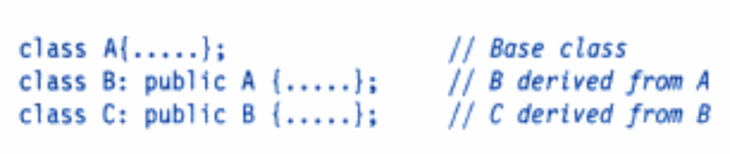
Multilevel Inheritance
The class A serves as a base class for the derived class B, which in turn serves as a base class for the derived class C.
Class B provides a link for the inheritance between A and C.
The chain A, B, C is known as inheritance path.
A
Base Class
Intermediate
Base Class
B
C
Derived Class

Slide 42
Multilevel Inheritance
continue …
class A { ………} ; // Base Class
class B : public A { ……… } ; // B derived from A immdediate
class C : public B { ……… } ; // C derived from B

Slide 43
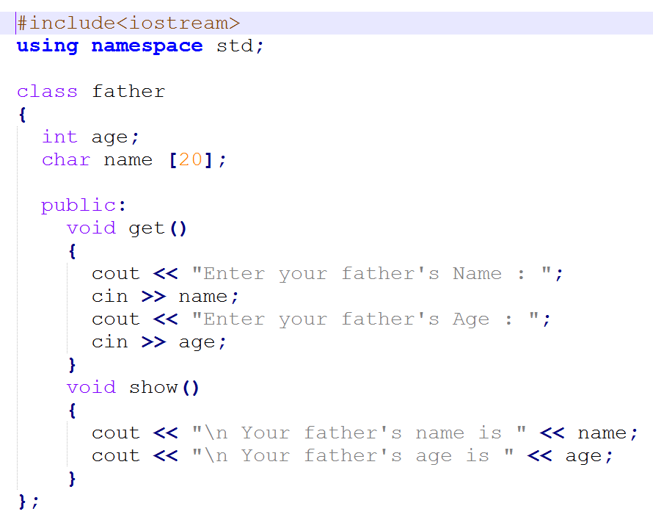

Slide 44
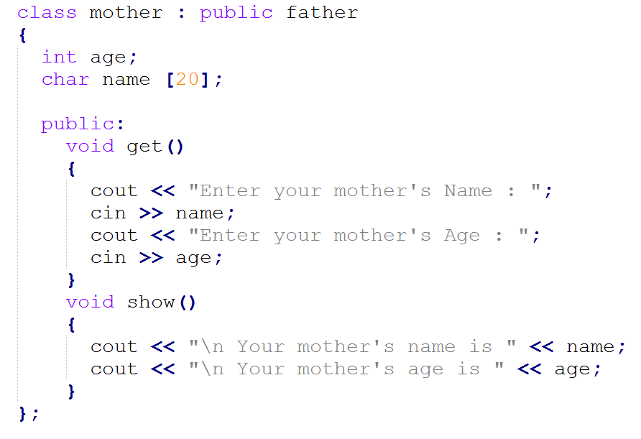

Slide 45
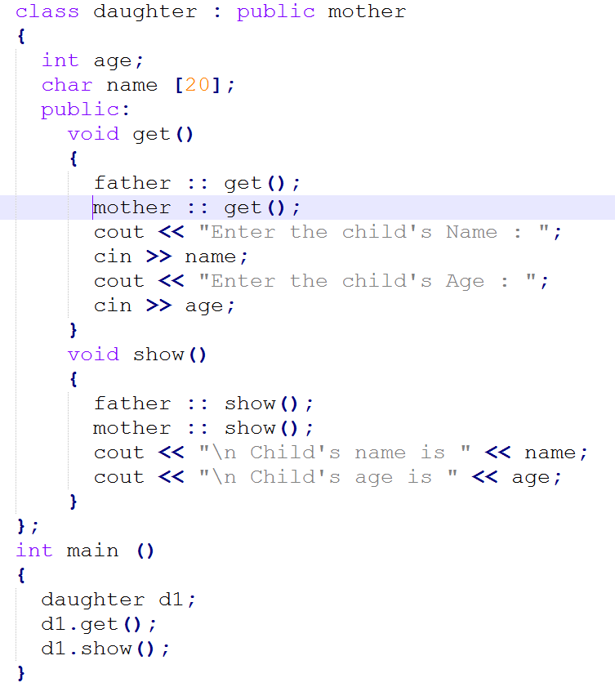
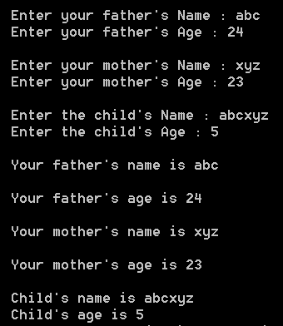
Output:

Slide 46
Multiple Inheritance
A class can inherit the attributes of two or more classes.
Multiple inheritance allows us to combine the features of several existing classes as a starting point for defining new classes.
It is like a child inheriting the physical features of one parent and the intelligence of another.
B-1
B-2
D

Slide 47
Multiple Inheritance
continue …
class D: visibility B-1, visibility B-2, ……
{
………
……… (Body of D)
………
};
Where, visibility may be either public or private.
The base classes are separated by comma.

Slide 48
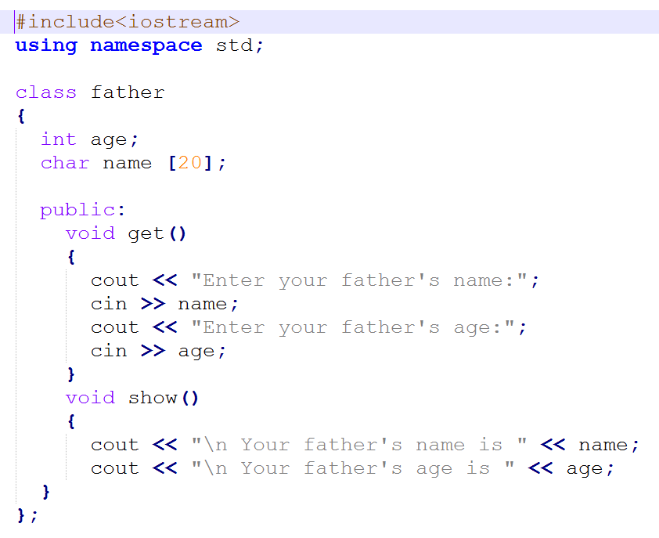

Slide 49
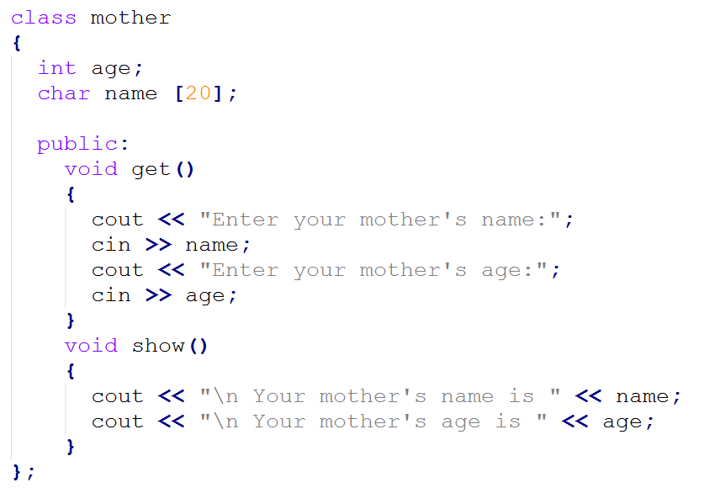

Slide 50
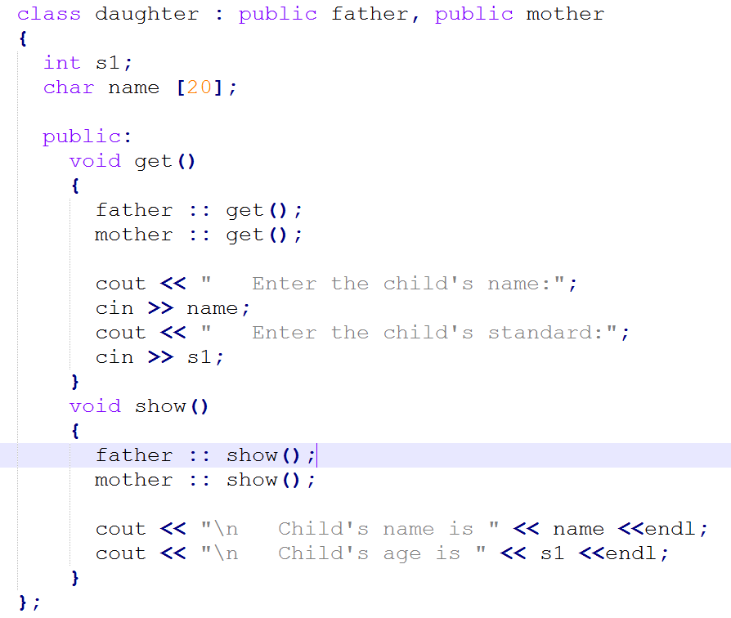

Slide 51
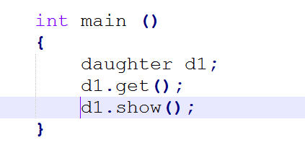
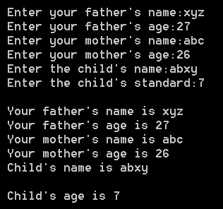
Output:

Slide 52
Ambiguity Resolution in Inheritance
class M
{
public:
void display (void)
{ cout << “Class M \n“;}
};
class N
{
public:
void display (void)
{ cout << “Class N \n“;}
};
class P : public M, public N
{
public:
void display (void)
{ M :: display();}
};
void main( )
{
P p;
p.display( );
}
In Multiple Inheritance

Slide 53
Ambiguity Resolution in Inheritance
class A
{
public:
void display (void)
{ cout << “Class A \n“;}
};
class B : public A
{
public:
void display (void)
{ cout << “Class B \n“;}
};
void main( )
{
B b;
b.display( ); // in B
b.A::display( ); // in A
b.B::display( ); // in B
}
Ambiguity can be resolved by specifying the function with class name and scope resolution operator to invoke.
In Single Inheritance

Slide 54
Hierarchical Inheritance
Inheritance support hierarchical design of a program.
Additional members are added through inheritance to extend the capabilities of a class.
Programming problems can be cast into a hierarchy where certain features of one level are shared by many others below that level
Account
SB
CA
FD
STD
LTD
MTD

Slide 55
Hybrid Inheritance
Applying Two or more types of inheritance together.
student
test
sports
result

Slide 56
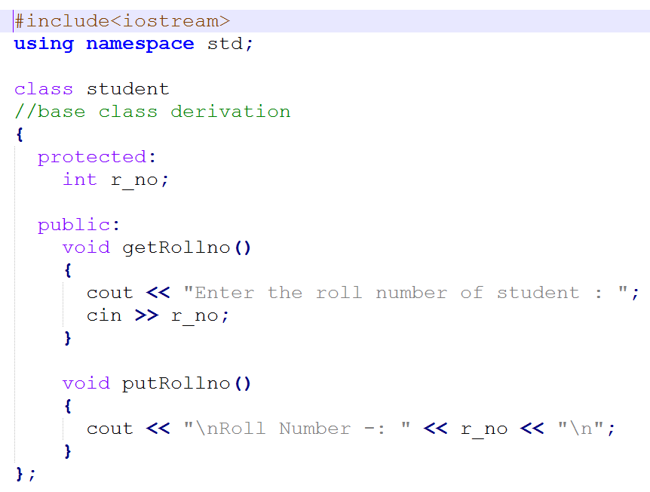

Slide 57
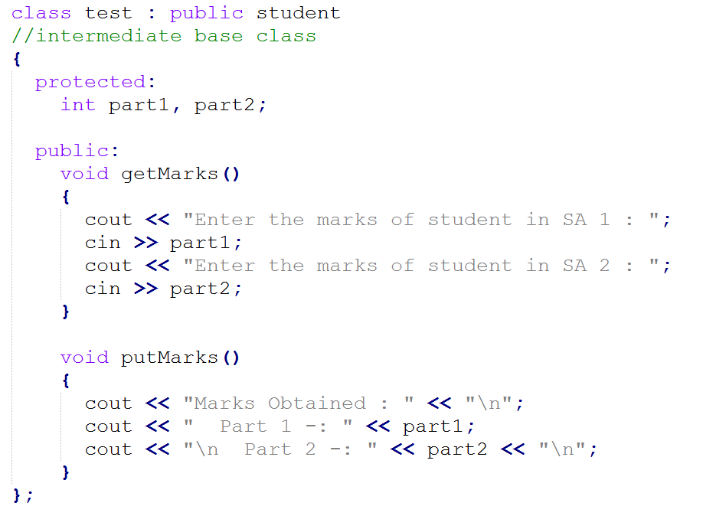

Slide 58
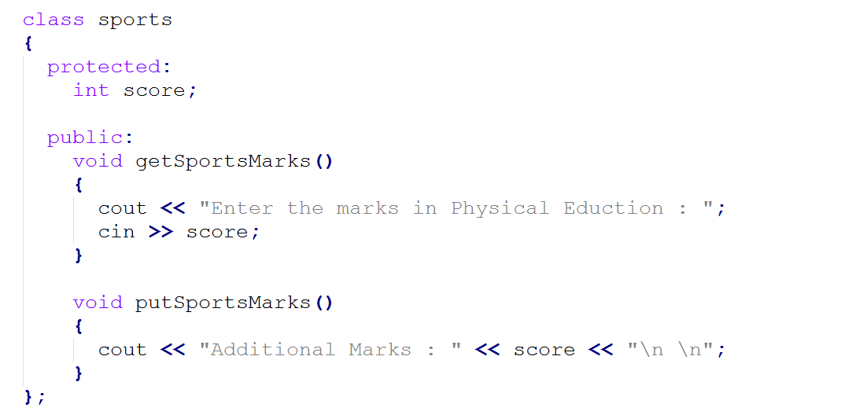

Slide 59

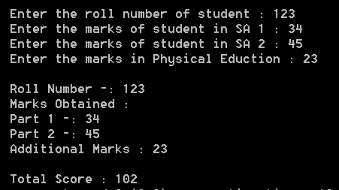
Output:

Slide 60
Virtual Base Classes
Here the result class has two direct base classes test and sports which themselves have a common base class student.
The result inherits the traits of student via two separate paths.
student
test
sports
result

Slide 61
Virtual Base Classes
continue …
It can also inherit directly as shown by the broken line.
The student class is referred to as indirect base class.
student
test
sports
result

Slide 62
Virtual Base Classes
continue …
All the public and protected members of student are inherited into result twice, first via test and again via sports.
This means result class have duplicate set of members inherited from student.
student
test
sports
result

Slide 63
Virtual Base Classes
class student
{
………
};
class test : virtual public student
{
………
};
class sports : virtual public student
{
………
};
class result : public test, public sports
{
………\
};
student
test
sports
result

Slide 64
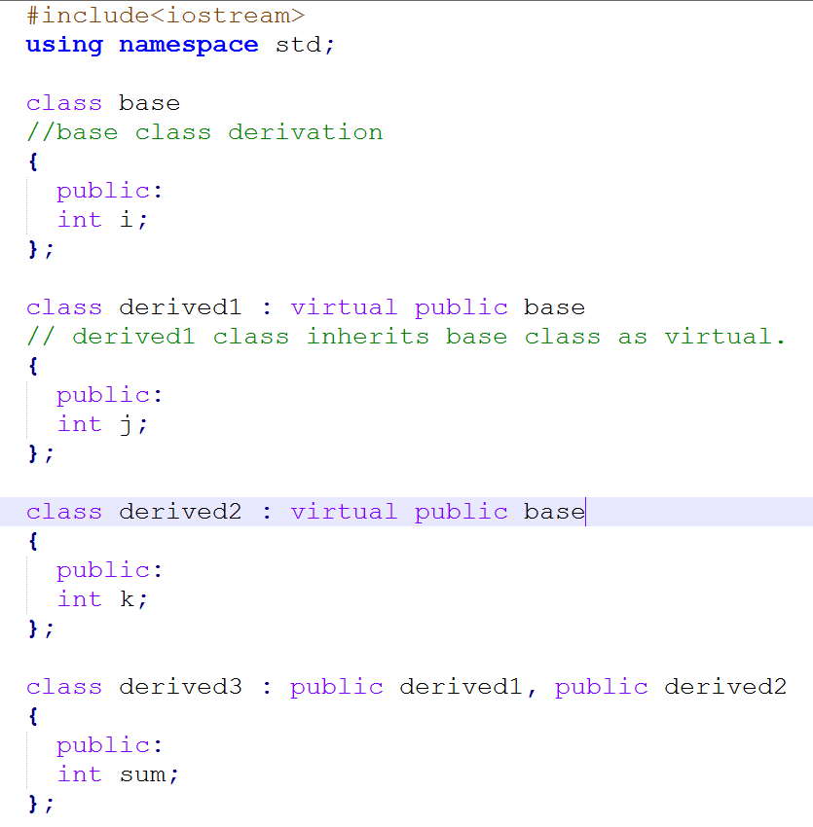


Slide 65
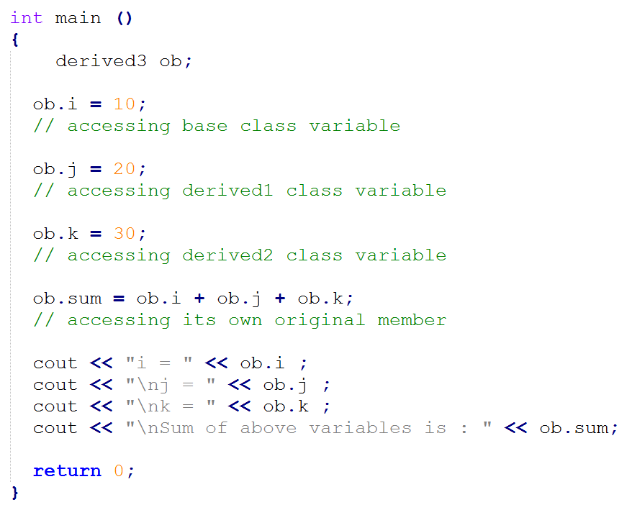
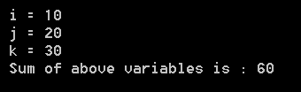
Output:

Slide 66
Abstract Classes
An abstract class is one that is not used to create objects.
An abstract class is designed only to act as a base class.
It is a design concept in program development and provides a base upon which other classes may be built.

Slide 67
Constructors in Derived Classes
If no base class constructor takes any arguments, the derived class need not have a constructor function.
If any base class contains a constructor with one or more arguments, then it is mandatory for the derived class to have a constructor and pass the arguments to the base class constructors.
When both the derived and base class contain constructors, the base constructor is executed first and then the constructor in the derived class is executed.
In case of multiple inheritance, the base class constructors are executed in the order in which they appear in the declaration of the derived class.

Slide 68
Constructors in Derived Classes
In a multilevel inheritance, the constructors will be executed in the order of inheritance.
Since the derived class takes the responsibility of supplying initial values to its base classes, we supply the initial values that are required by all the classes together, when a derived class object is declared.
The constructor of the derived class receives the entire list of values as its arguments and passes them on to the base constructors in the order in which they are declared in the derived class.
The base constructors are called and executed before executing the statements in the body of the derived constructor.

Slide 69
Constructors in Derived Classes
The header line of derived-constructor function contains two parts separated by a colon (:).
    The first part provides the declaration of the arguments that are passed to the derived constructor.
    The second part lists the function calls to the base constructors.

Slide 70
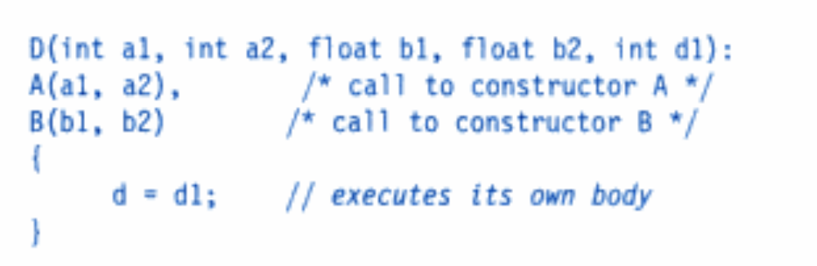
Defining Derived Constructors
Derived-constructor(Arglist1, Arglist2, … ArglistN, ArglistD) :
base1(arglist1),
base2(arglist2),
…
baseN(arglistN)
{
}
continue …

Slide 71
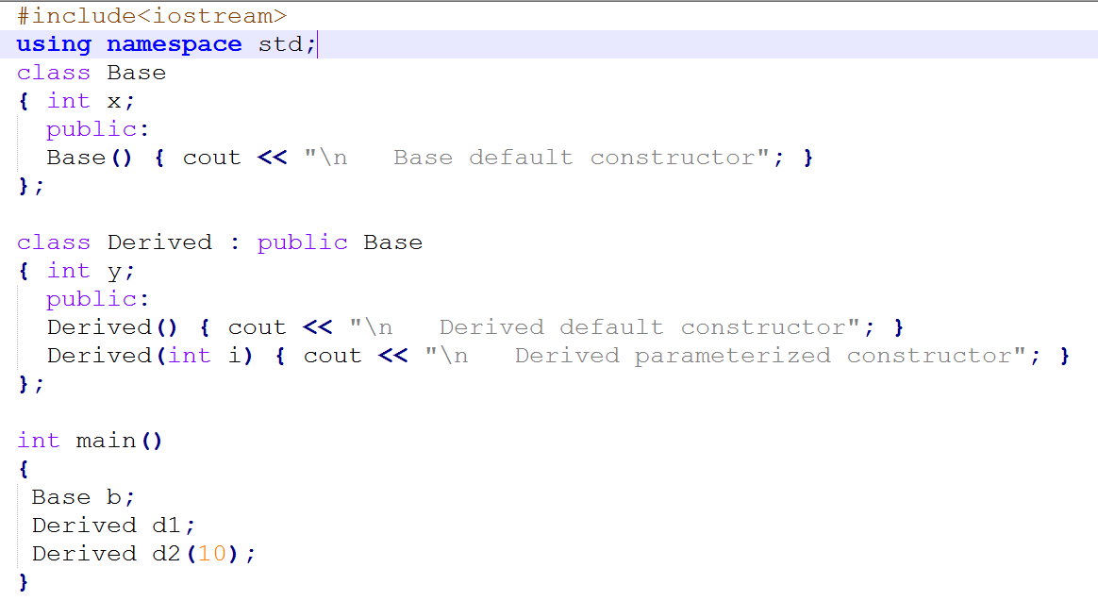
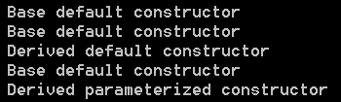
Output:

Slide 72
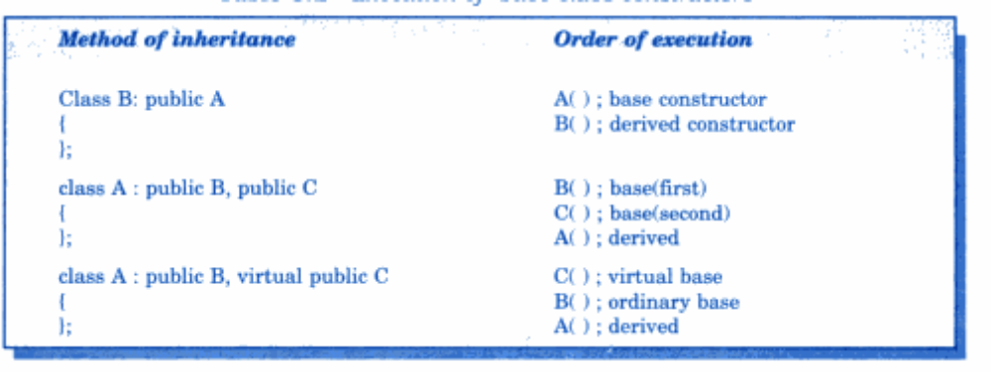
Order of execution

Slide 73
Member Classes : Nesting of Classes
Inheritance is the mechanism of deriving certain properties of one class into another.
C++ supports a new way of inheriting classes:
    An object can be collection of many other objects.
    A class can contain objects of other classes as its members.

Slide 74
Member Classes : Nesting of Classes
continue …
class alpha { ……… };
class beta { ……… };
class gamma
{
alpha a; // an object of class alpha
beta b; // an object of class beta
………
};

Slide 75
Member Classes : Nesting of Classes
class alpha { ……… };
class beta { ……… };
class gamma
{
alpha a;
beta b;
………
};
All objects of gamma class will contain the objects a and b.
This is called containership or nesting.

Slide 76
Member Classes : Nesting of Classes
An independent object is created by its constructor when it is declared with arguments.
A nested object is created in two stages:
    The member objects are created using their respective constructors.
    Then ordinary members are created.
Constructors of all the member objects should be called before its own constructor body is executed.

Slide 77
Member Classes : Nesting of Classes
class gamma
{
………
alpha a;
beta b;
public:
gamma(arglist): alpha(arglist1), beta(arglist2)
{ body of the constructor }
};

Slide 78







Presentation Prepared By:
  Contact us:
  dweepnagarg.ce@charusat.ac.in
  parthgoel.ce@charusat.ac.in
  hardikjayswal.it@charusat.ac.in
  dipakramoliya.ce@charusat.ac.in
  krishnapatel.ce@charusat.ac.in
  khushipatel.ce@charusat.ac.in
  Ms. Khushi Patel
Subject Teachers:
  Ms. Dweepna Garg
  Subject Coordinator
  Ms. Krishna Patel
  Mr. Parth Goel
  https://parthgoelblog.wordpress.com
Mr. Hardik Jayswal
Devang Patel Institute of Advance Technology and Research

Slide 79
Thank You

